Slide 1
GluonCV
Tong He
Applied Scientist, Amazon Web Services.
2018.12.17

Slide 2
GluonCV: A Vision Toolkit
State-of-the-Art Models
Fast Development
Easy Deployment
Official Maintainance

Slide 3
The Best Open-Source Choice
Pretrained Models with the Best Accuracy
Most Comprehensive Model Zoo

Slide 4
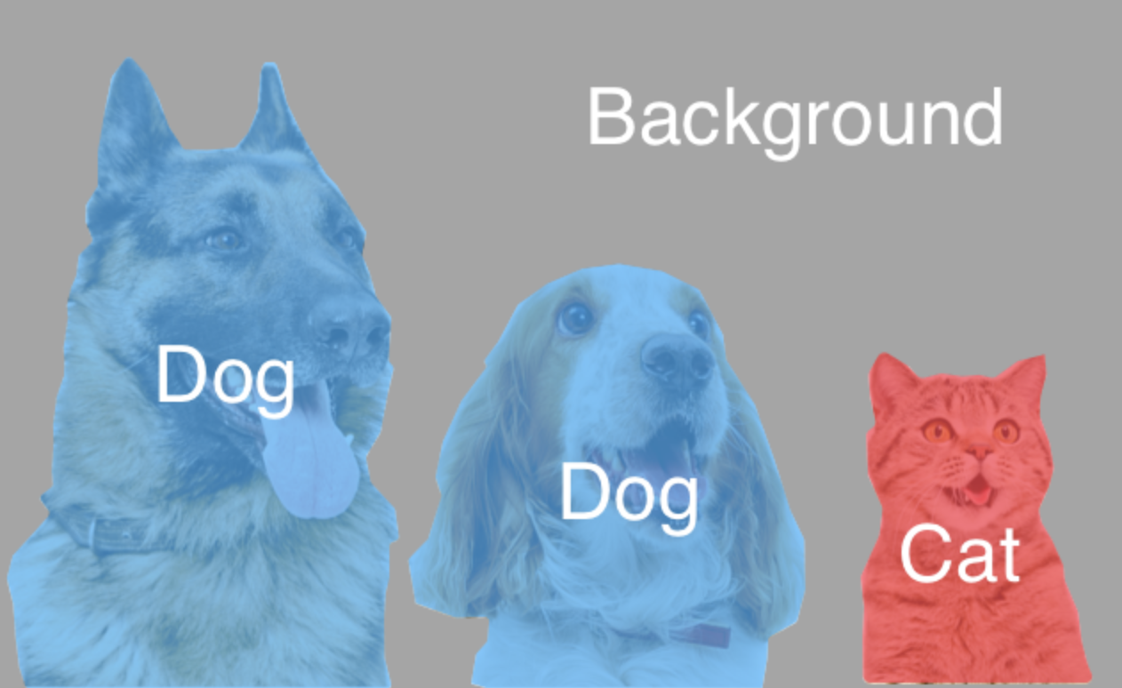
Models
Classification
Detection
Segmentation

Slide 5
Models
Classification
Model | Ours | Reference
ResNet-50 | 79.2% | 76.2%
ResNet-101 | 80.5% | 77.4%
MobileNet | 73.3% | 70.9%

Slide 6
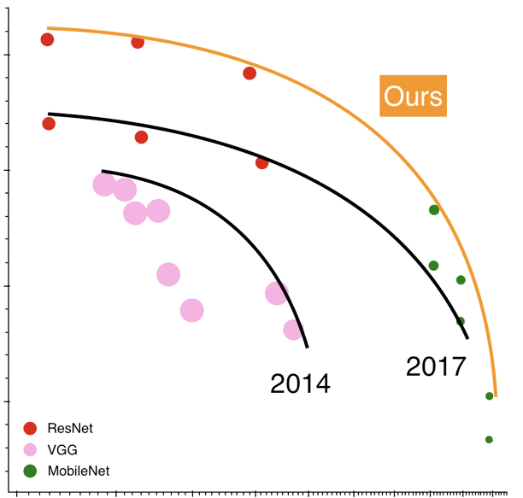
Models
Classification

Slide 7
Models
Detection
Model | Ours | Reference
Faster-RCNN | 40.1% | 39.6%
YOLOv3 | 37.0% | 33.0%

Slide 8
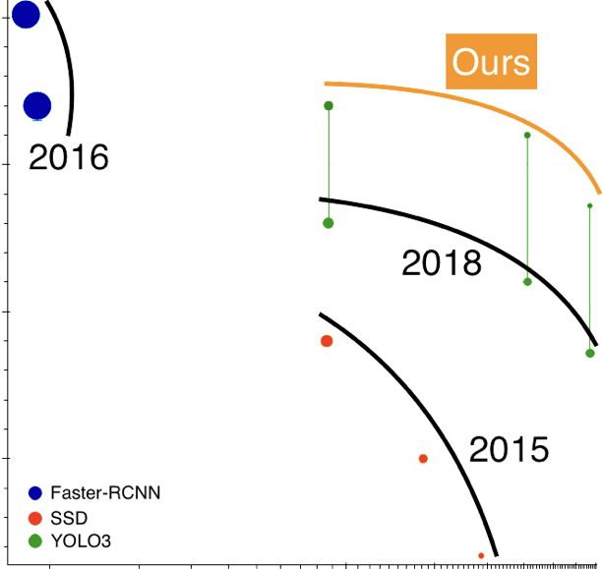
Models
Detection

Slide 9
Models
Segmentation
Model | Ours | Reference
Mask-RCNN | 33.1% | 32.8%
DeepLab-v3 | 86.7% | 85.7%

Slide 10
Models
Available
Classification
Detection
Segmentation
Re-ID
GAN
In-Development
Keypoint detection
Depth prediction

Slide 11
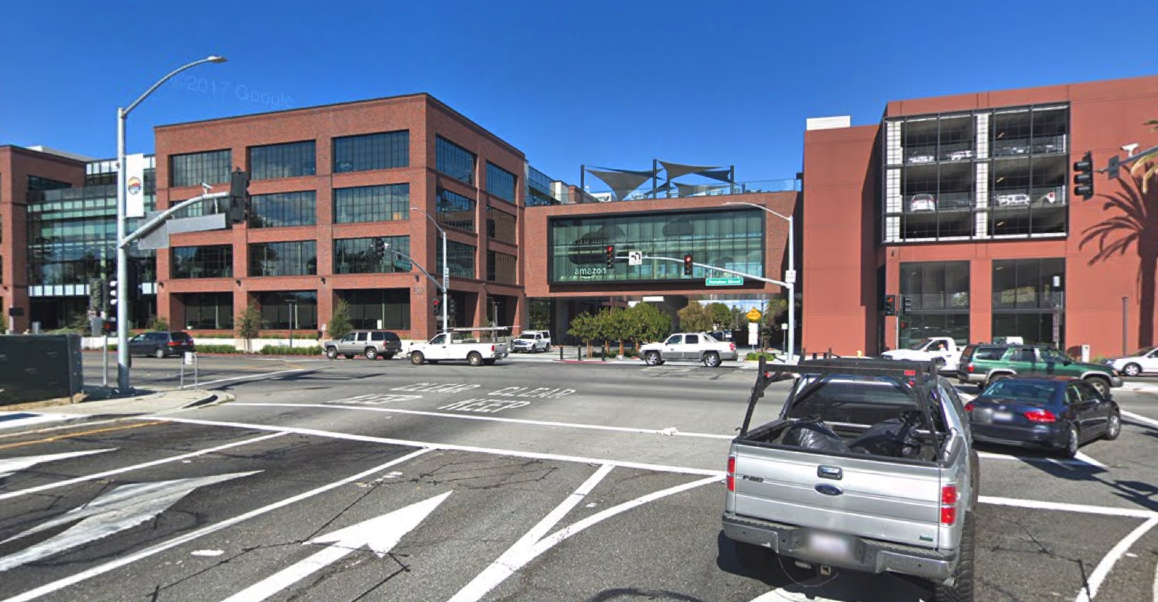
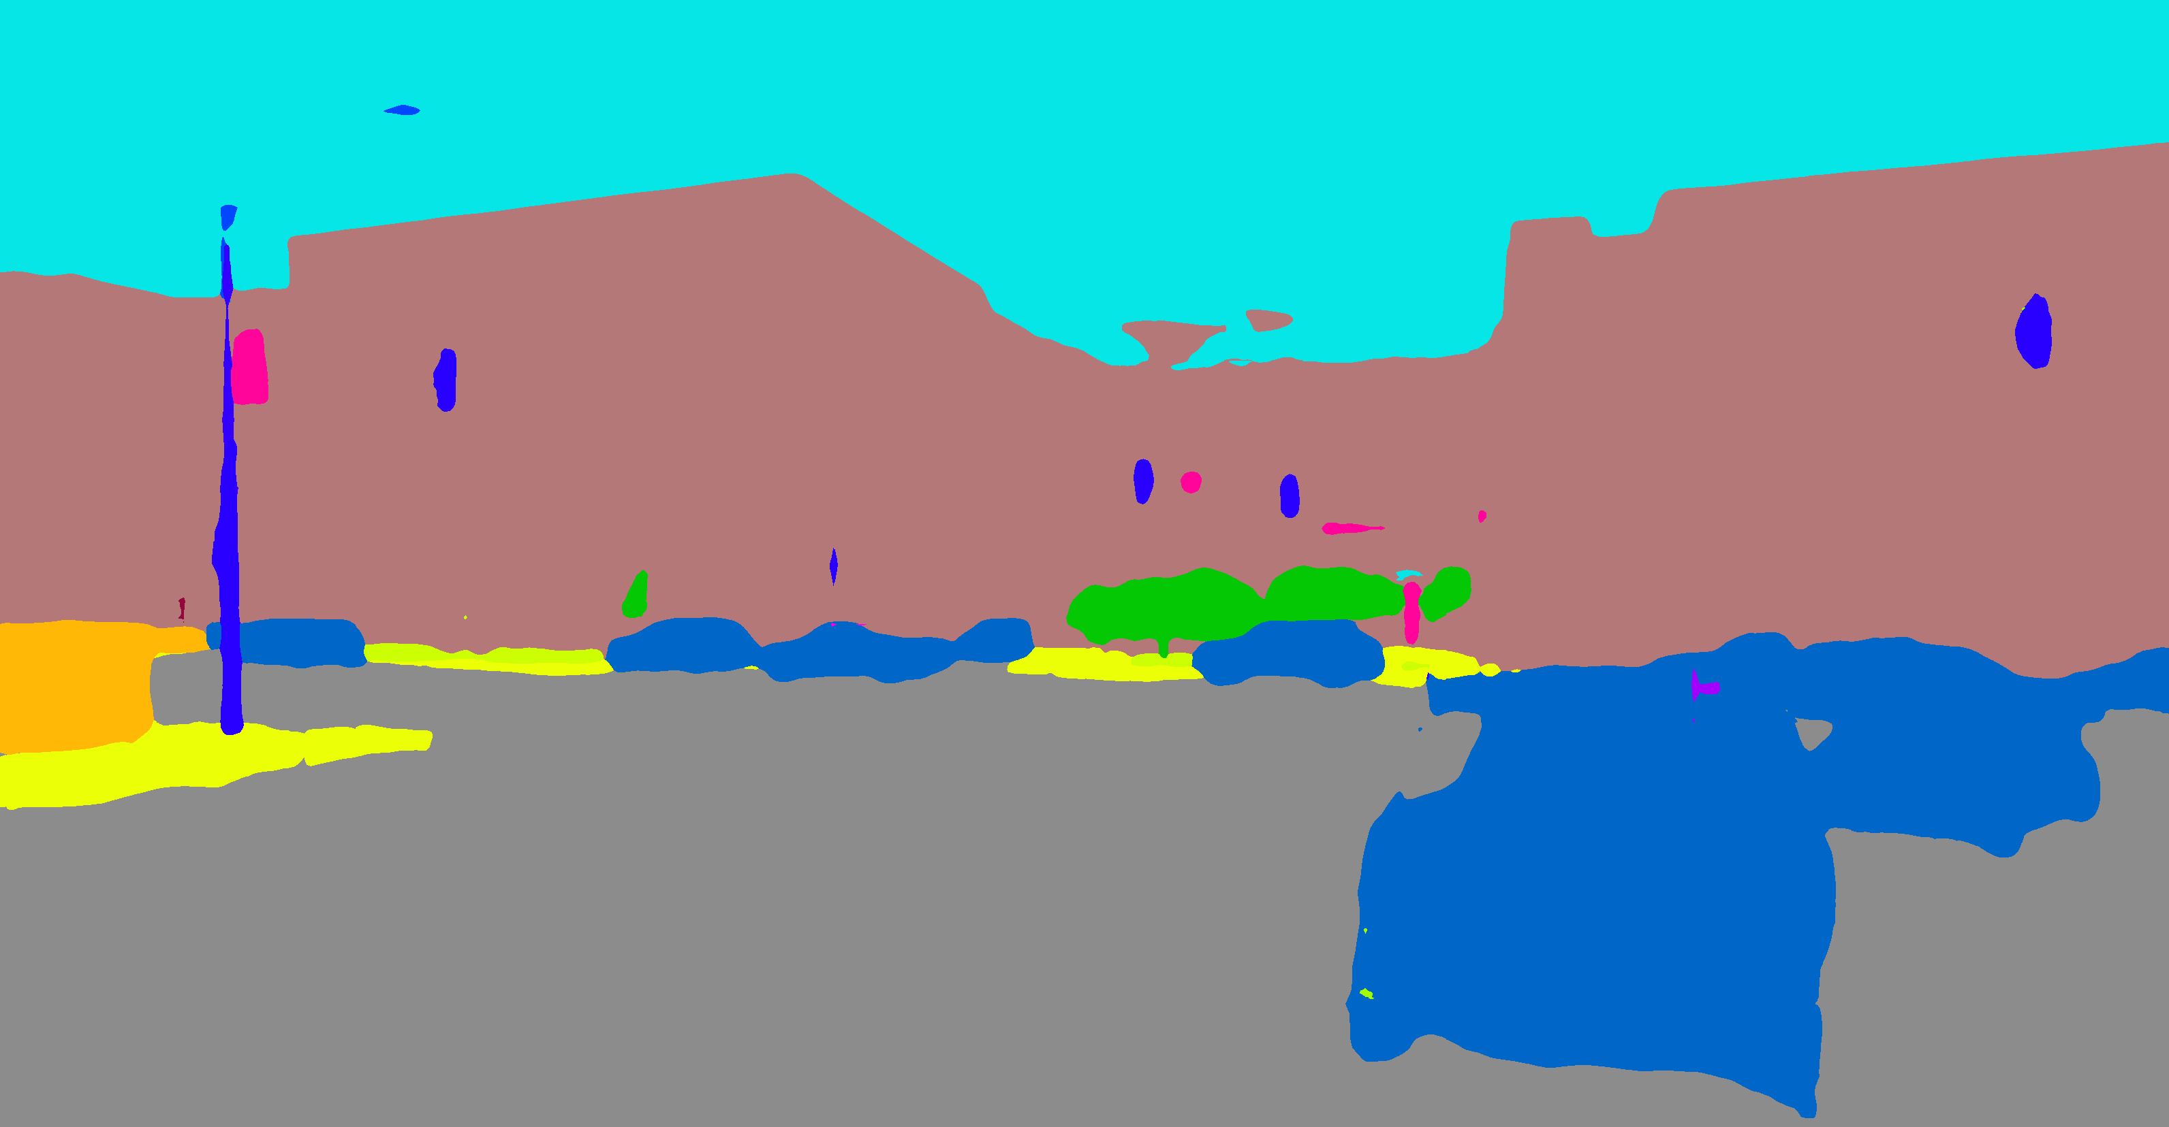
Demo
Detection
Segmentation

Slide 12
Demo
WGAN
Person Re-ID

Slide 13
Getting Started
Gluon CV: https://gluon-cv.mxnet.io
Gluon NLP: https://gluon-nlp.mxnet.io
MXNet: http://beta.mxnet.io/
Deep Learning Book: http://diveintodeeplearning.org

